Slide 1

NumPy Overview and Useful Tips Data-X: A Course on Data, Signals, and Systems
Data ^{X}
About Me:
Ikhlaq Sidhu Chief Scientist & Founding Director, Sutardja Center for Entrepreneurship & Technology IEOR Emerging Area Professor Award, UC Berkeley

Slide 2
Today
NumPy Overview
Numpy Notebook from Data-x.blog and Dropbox Module 1:
See Ref CS02: NumPy Getting Started v1-12
These Slides from Data-x.blog and Dropbox Module 1:
Project Ideation
Homework for next week:
To be posted via Bcourses
Notes:
Numpy - is a part of a SciPi, a set of packages, open source, and works with Python, and written for science, math, engineering:
Includes: Numpy, MathplotLib, Sympy, ScyPi library, Ipython, and pandas
Comments on class:
Most people: math, no problem
Python – mixed, some of you are very experienced, far beyond what you will need for th course
But many of you have a rough working knowledge of Python.
So we will try to
Who will get in:
* Some will not have background
Look at HW and attendance
Look at who can not wait for a semester, ie graduating
Decide in about 1 week or two
Last hour: break into teams
Compare your best idea, pitch in 2 min each.
Vote and decide what is the most interesting
-> start with notebook

Slide 3
Arrays using NumPy
Helpful tips beyond the Numpy Notebook
Common mistakes
For more information, please review at:
https://docs.scipy.org/doc/numpy-dev/user/quickstart.html
See section 3 to understand strings and list

Slide 4
Create a NumPy Array
Creating arrays in NumPy, however, is different from creating the array.array library in Python. Here is how you do it:

Slide 5
Multidimensional Arrays
NumPy arrays can also be multidimensional
a = np.array([ [1, 2, 3], [4, 5, 6] ])
b = np.array([ [7, 8, 9], [10, 11, 12] ]) a and b are two 2D arrays (NumPy matrices)
a.shape Returns the array’s dimensions, here: (2, 3)
Basic math work on multidimensional arrays
a+b, a-b, a*b, a/b performs elementwise addition, subtraction, multiplication, and division
np.dot(np.transpose(a),b) performs matrix multiplication of a^{T} and b
Notes:
x = np.array() creates an array from a tuple.
2 * x will change every element of x to 2 times the value.
2 * [1,2,3] will not do that, [1,2,3,1,2,3] instead
Includes start, but does not include the end value

Slide 6
Use linespace for evenly spaced points in a range
Suppose you want an array with 9 points evenly spaced from 0 to 2?

Slide 7
Use linespace for evenly spaced points in a range
Suppose you want an array with 9 points evenly spaced from 0 to 2?

Slide 8
Comparisons

Slide 9
If You need Random Numbers, no problem. Look up np.random.random
Also see
np.zeros and np.ones
https://docs.scipy.org/doc/numpy/reference/generated/numpy.random.random.html

Slide 10
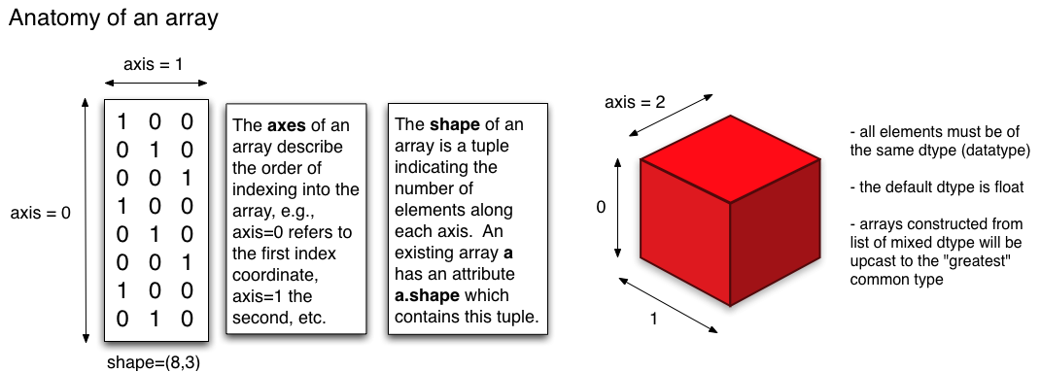
Anatomy of an Array
In NumPy, dimensions are called axes and the number of axes is called a rank.

Slide 11
Using the axis parameter with methods like sum, min, and others

Slide 12
Using the axis parameter with methods like sum, min, and others

Slide 13
Using the axis parameter with methods like sum, min, and others

Slide 14
Using the axis parameter with methods like sum, min, and others

Slide 15
Slicing a NumPy Array, 1-Dimension
>>> x = np.array([0, 1, 2, 3, 4, 5, 6, 7, 8, 9])
>>> x[1:7:2]
array([1, 3, 5])
start:stop:step
i:j:k
>>> x[-2:10] array([8, 9])
>>> x[-3:3:-1]
array([7, 6, 5, 4])
Negative i and j are interpreted as n + i and n + j where n is the number of elements in the corresponding dimension. Negative k makes stepping go towards smaller indices.
Note
In Python, x[(exp1, exp2, ..., expN)] is equivalent to x[exp1, exp2, ..., expN]; the latter is just syntactic sugar for the former.

Slide 16
Slicing a NumPy Array, 1-Dimension
>>> x = np.array([0, 1, 2, 3, 4, 5, 6, 7, 8, 9])
>>> x[1:7:2]
array([1, 3, 5])
start:stop:step
i:j:k
>>> x[-2:10]
array([8, 9])
>>> x[-3:3:-1]
array([7, 6, 5, 4])
Negative i and j are interpreted as n - i and n - j where n is the number of elements in the corresponding dimension. Negative k makes stepping go towards smaller indices.
Note
In Python, x[(exp1, exp2, ..., expN)] is equivalent to x[exp1, exp2, ..., expN]; the latter is just syntactic sugar for the former.

Slide 17
Slicing a NumPy Matrix Works the Same Way You get a new “view” of a section of the of the original matrix
data = np.random.random((1000,4))
print data
[[ 0.81946001 0.24377412 0.95235583 0.58232243]
[ 0.58229757 0.12284915 0.83731775 0.52798616]
[ 0.6921377 0.08912797 0.39800043 0.66288952]
...,
[ 0.83346456 0.20024193 0.86708519 0.09500233]
[ 0.27112654 0.72018064 0.17056836 0.26202908]
[ 0.22147895 0.27752412 0.52697043 0.36483595]]
data[ 1:6:1, 0:3:1 ]
array([
[ 0.58229757, 0.12284915, 0.83731775],
[ 0.6921377 , 0.08912797, 0.39800043],
[ 0.84952767, 0.1318117 , 0.61345601],
[ 0.3038797 , 0.81956695, 0.9835471 ],
[ 0.15578211, 0.99188135, 0.63214512]])
Rows 2 to 6, Columns 1 to 3
Same as data[1:6,0:3]
data[1:6,0:3] = 0, will assign those as 0
More notation:
b[0:5,1] gives you rows 0:5, and column 2
b[:,1] give you the same thing if b has 5 rows

Slide 18
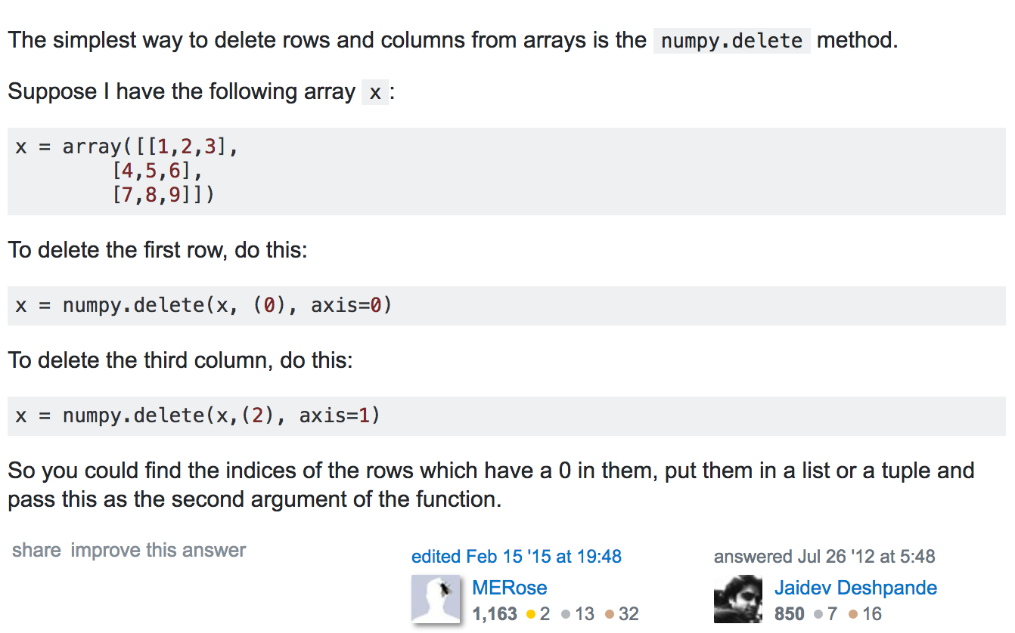
Delete for Slicing a NumPy array (matrix)
But be careful, it will really be gone.
From stackoverflow

Slide 19
Stacking Matrices: See hstack and vstack
Also see:
numpy.column_stack: its like hstack, but for 1 column at a time
numpy.concatenate: join a sequence of arrays along an existing axis

Slide 20
You can also split matrices: hsplit and vsplit

Slide 21
Flatten (use ravel) and the reshape array:

Slide 22
A Note on Copies
Assignment:
Shallow Copy: A Slice is a View of the data. Changes format, but the data is still the same
Deep Copy:

Slide 23
A Note on Copies
Assignment:
Shallow Copy: A Slice is a View of the data. Changes format, but the data is still the same
Deep Copy:

Slide 24
A Note on Copies
Assignment:
Shallow Copy: A Slice is a View of the data. Changes format, but the data is still the same
Deep Copy:

Slide 25
End of Section

